Slide 1
Detecting Fake News -
A Machine Learning Approach
Ujjwal Samanta

Slide 2
Problem Statement
The primary objective of this project is to create a robust fake news detection system that leverages text-based and image - based data.

Slide 3
Data Collection
Dataset Used for this project form Kaggle called “WELFake Dataset”.
It has 5 features namely id, title, author, text, label
WELFake is a dataset of 72,134 news articles with 35,028 real and 37,106 fake news.
For this, authors merged four popular news datasets i.e. Kaggle, McIntire, Reuters, BuzzFeed Political.

Slide 4
Text Based News Detection

Slide 5
Text-Based Approach
Data Collection: Gather a diverse dataset containing labeled examples of fake and authentic news articles.
Text Preprocessing: Clean and tokenize text, remove stop words, and convert to a format suitable for machine learning.
Feature Extraction: Utilize techniques such as TF-IDF, word embeddings, or BERT embeddings for feature representation.
Model Development: Train and evaluate machine learning models (e.g., Random Forest, Naive Bayes) for text-based classification.

Slide 6
Data Cleaning
Punctuation: Remove punctuation marks (., !, ?, etc.) from the text.
Stopwords: Remove common words (e.g., "the," "and," "is") that don't carry much meaning.
Numbers: Remove numeric characters or words.
HTML tags: If your text data comes from web scraping, you may need to remove HTML tags.
URLs: Remove web URLs or hyperlinks.
Special characters: Remove special characters that are not relevant to the analysis.
Lowercasing: Convert all text to lowercase to ensure consistency.
Whitespace: Remove extra whitespaces or tabs.
Abbreviations and acronyms: Standardize or expand abbreviations and acronyms.
Rare words: Remove words that appear very infrequently in the dataset.
Stemming or Lemmatization: Reduce words to their base or root form for better analysis.
Non-text characters

Slide 7
Tokenization is a fundamental step in natural language processing (NLP) and text analysis, as it provides a structured way to analyze and understand the content of text data.
Tokenization

Slide 8
Vectorization in text analysis is the process of converting text data into numerical vectors that machine learning algorithms can work with.
vectorization

Slide 9
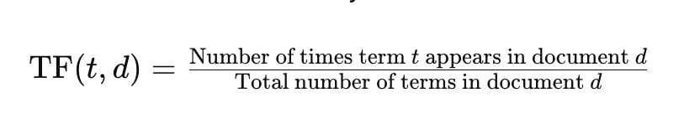
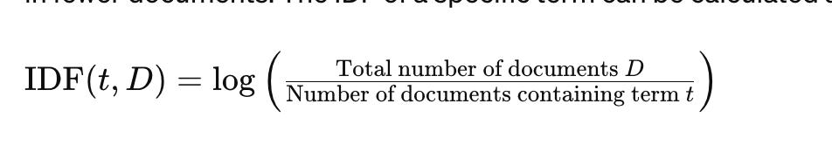
Vectorization - TF-IDF (Term Frequency-Inverse Document Frequency)
Term Frequency (TF)
Term Frequency measures how frequently a term occurs in a document.
Inverse Document Frequency (IDF)
Inverse Document Frequency measures how important a term is within the entire corpus.

Slide 10
Training - 70% Test - 30%
Splitting Dataset

Slide 11
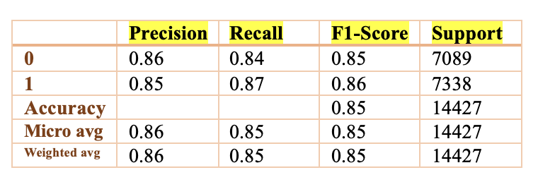
Classification Report
Naïve Bias Classifier

Slide 12
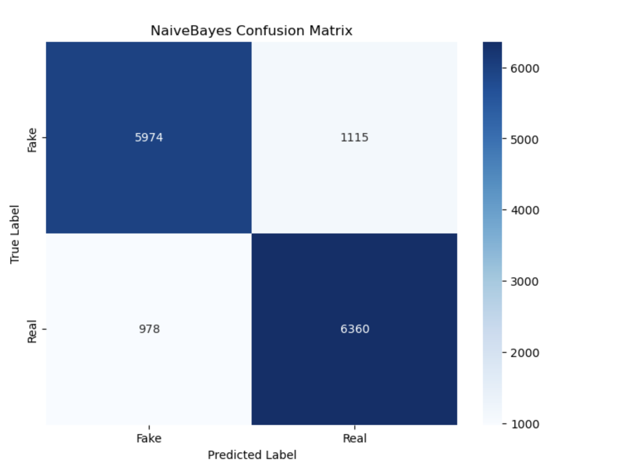
Confusion Matrix

Slide 13
Feature Weights (-)
unnervingly
unnecessarily
objectionable
obligated
unobserved
obstructed
occupied
unofficial
unparallel
pardonable
unpartisan
unpatriotic
paved
unpaid
unpardonable
unpegged
Permitted
Persuaded
precedented

Slide 14
Feature Weights (+)
unrealistic
unreasonable
reconciled
unrecorded
regulated
unrehearsed
Unreimbursed
profitable
Provoked
reconciled
regulated
remitted
unrest
unrestrained
restricted
rivaled
secured
quantifiable
quenched
questionable
unquestioningly

Slide 15
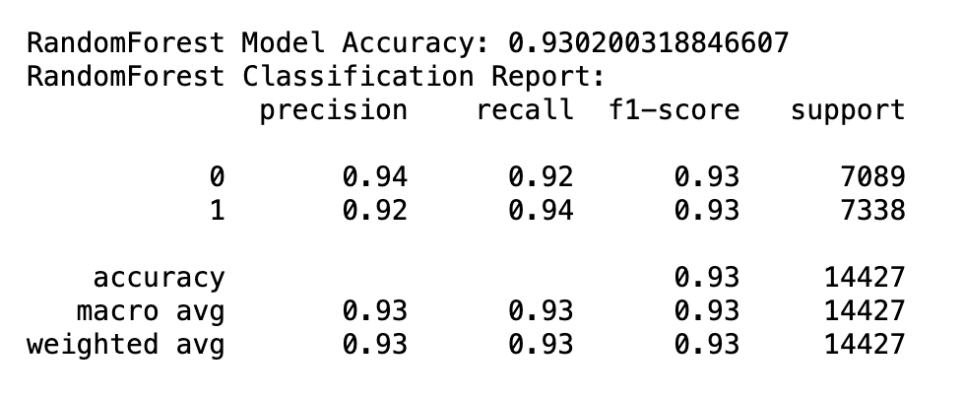
Classification Report
Random Forest Classifier

Slide 16
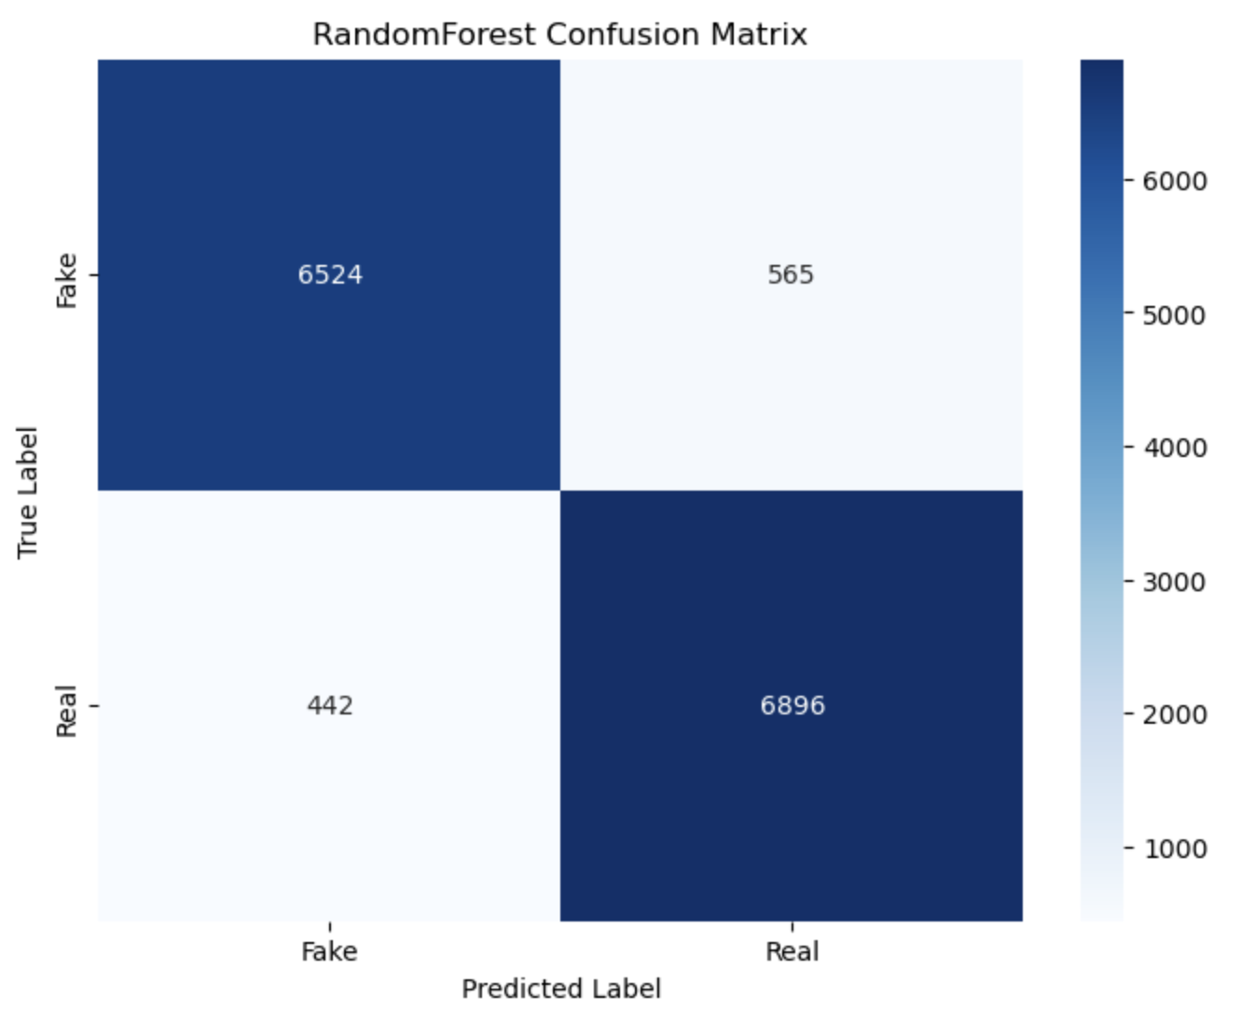
Confusion Matrix

Slide 17
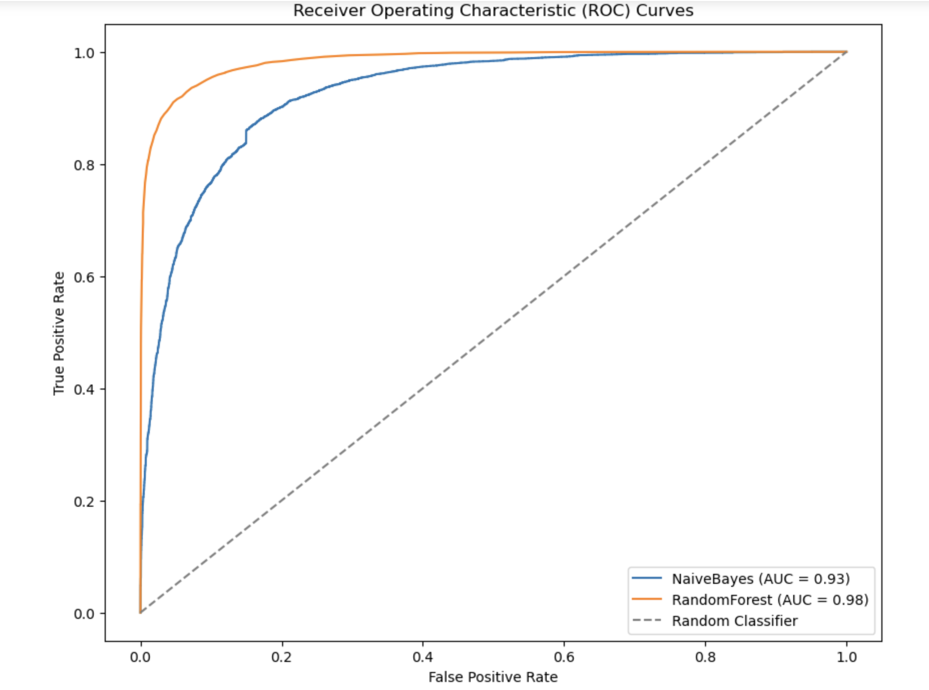
Receiver Operating Characteristic (ROC)

Slide 18
Steps for LSTM
Sentence Tokenization: split the preprocessed text from the 'data' DataFrame into lists of words, preparing it for the Word2Vec training.
Word2Vec Training: train a Skip-Gram model using the gensim library on the tokenized sentences.
Model Saving and Verification: The trained Skip-Gram model is saved to disk.
Text Tokenization for Model Input: Using Keras Tokenizer, convert the preprocessed text into sequences of integers.
Load Pre-trained Word2Vec Model: The Word2Vec model that was saved earlier is loaded from the specified path. This model contains the word embeddings trained using the Skip-Gram method.
Creating an Embedding Matrix
Used Embedding Matrix for LSTM

Slide 19
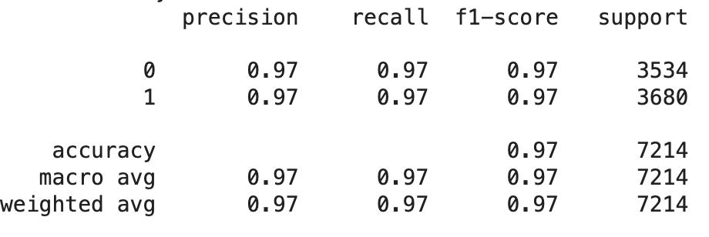
Classification Report
Accuracy – 97%
LSTM
model

Slide 20
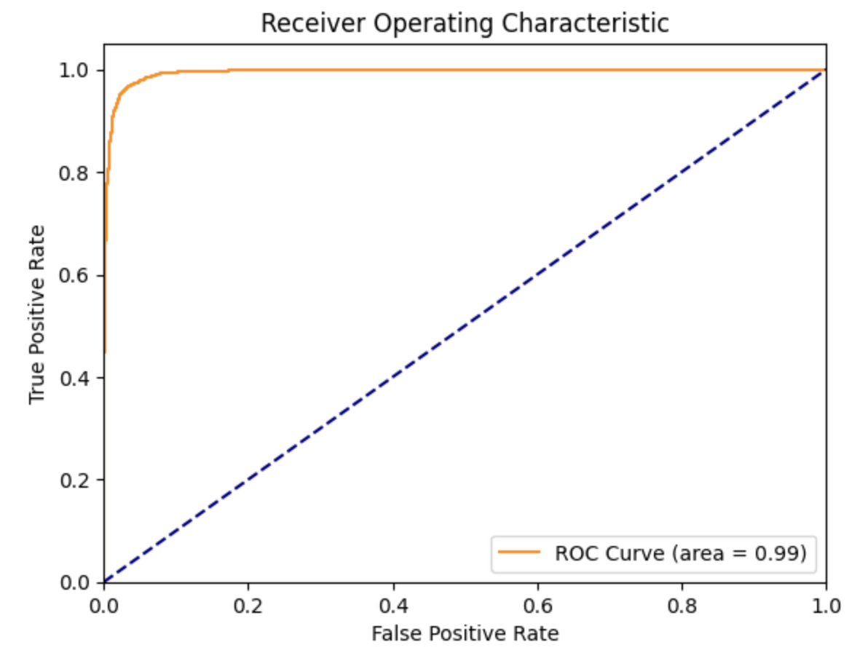
Receiver Operating Characteristic (ROC)

Slide 21
(Text) Imaged Based News Detection

Slide 22

Library Used - PILLOW
Pillow is a Python Imaging Library (PIL), which adds support for opening, manipulating, and saving many different image file formats.
It is an open-source library, originally forked from the Python Imaging Library (PIL), hence the name Pillow.
Pillow provides a wide range of image processing capabilities, including resizing, cropping, rotating, filtering, and enhancing images.
Keras - Utilized Keras for building a Convolutional Neural Network (CNN) to classify images.

Slide 23
Methodology
Data Preparation:
Converted textual news entries into images, labeled as 'fake' or 'original', using Pillow.
Data Organization:
Created dedicated directories for original and fake news images, facilitating systematic data management.
Data Splitting:
Divided the dataset into training and testing sets to evaluate the model's performance accurately.

Slide 24
CNN Model Architecture
Designed a CNN with multiple convolutional and max pooling layers to extract features from images.
Included flatten and dense layers for feature interpretation and final classification.
Compiled the model with Adam optimizer and binary cross-entropy loss function, focusing on accuracy as the primary metric.

Slide 25
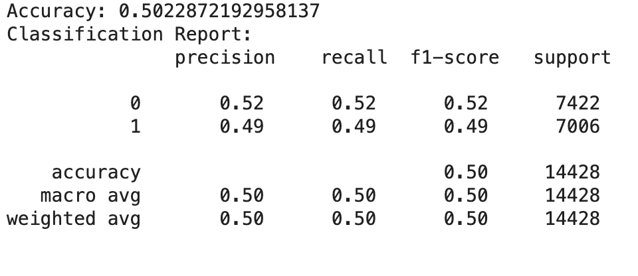
Classification Report
CNN

Slide 26
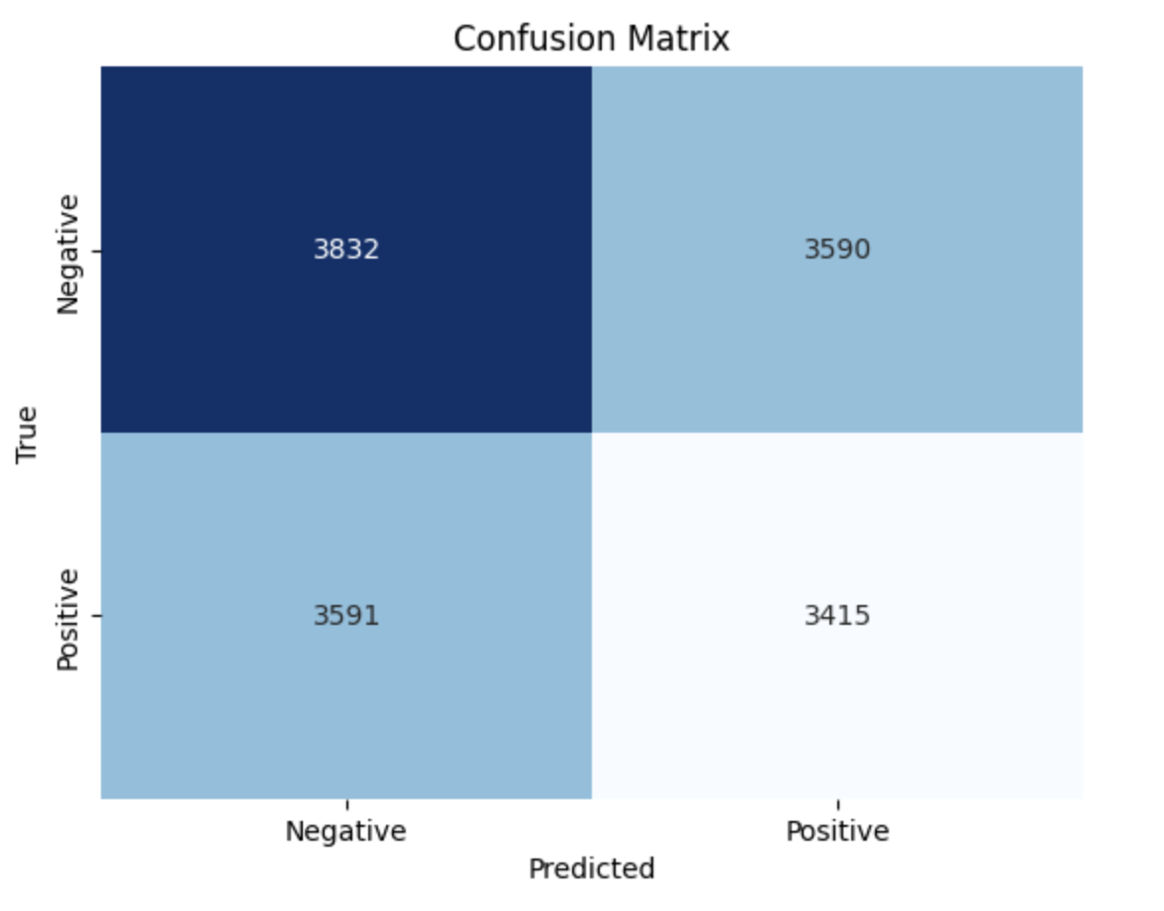
Confusion Matrix
Confusion Matrix

Slide 27
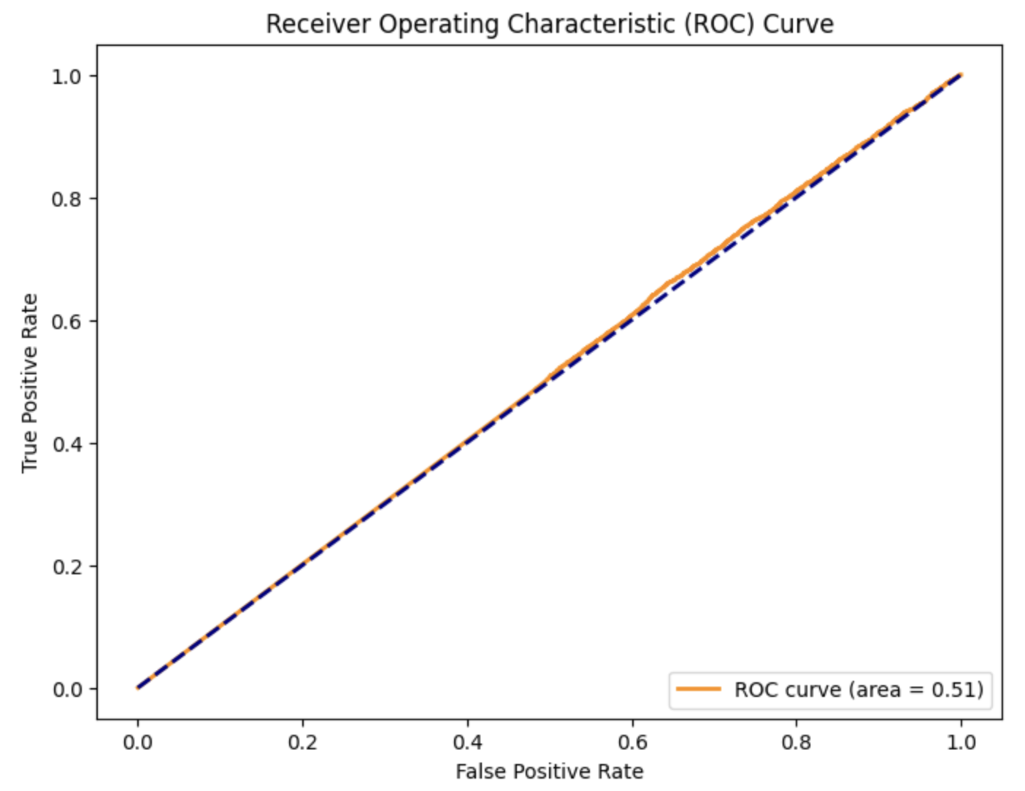
ROC curve

Slide 28
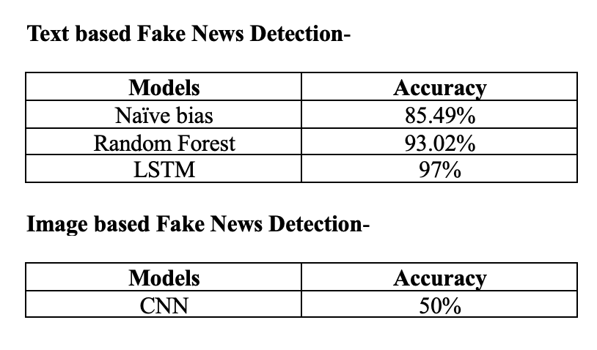
Conclusion

